Slide 1

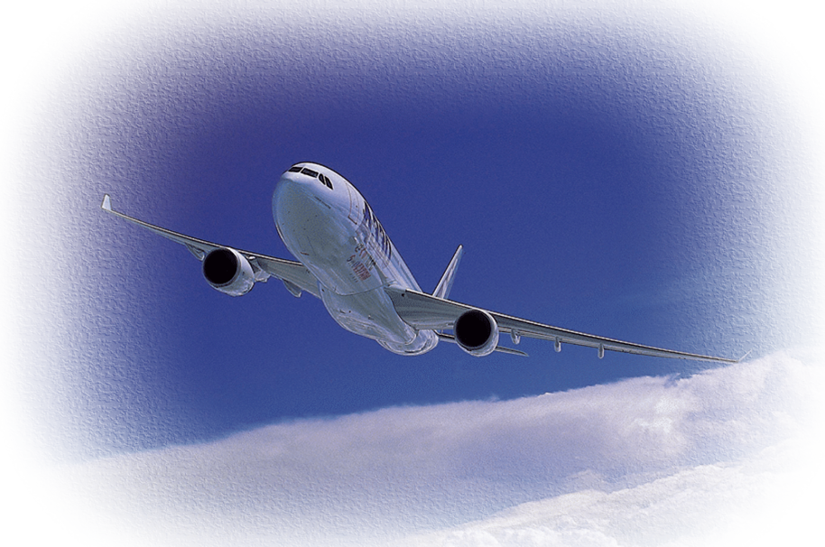
The Importance of Synergy Between
Flight Deck and Cabin Crews
This presentation is intended to enhance the reader's understanding, but it shall not supersede applicable regulations or airline operational documentation. Should there be any discrepancy between this presentation and the AFM/(M)MEL/FCOM/QRH/FCTM, the latter shall prevail at all times.

Slide 2
Introduction
This visual guide explores the benefits to be derived from productive interactions or “synergy” between flight deck and cabin crewmembers, especially in emergency situations. Its objective is to demonstrate the importance of building effective communications that bridge gaps and promote flight deck and cabin crewmembers working together as an integrated team. The material may be used for self-study or as part of a formal training presentation.

Slide 3
Contents
    Issues
    Two Crews or One?
    Information Transfer Model
    Barriers
    Stress and Synergy
    Recommendations

Slide 4
Issues Related to Crew Interactions
Problems arise in the interactions between flight deck
and cabin crewmembers, especially when they need to work through an emergency together, because:
Two different cultures create barriers
There is limited joint training between flight deck and cabin crewmembers
Schedules constrain both formal and informal interactions
Stress generated during emergencies affects communication

Slide 5
Two Different Crews – One Team
Although all crewmembers share the same
ultimate goals of safety and efficiency, there are
fundamental differences between the duties of the
flight crew and those of the cabin crew.
Flight crew – control the aircraft and get it safely to its destination
Cabin crew – attend to passenger safety and comfort during the flight
In spite of these differences, safety and efficiency
are maximized when the flight and cabin crews
work together as an integrated team.

Slide 6
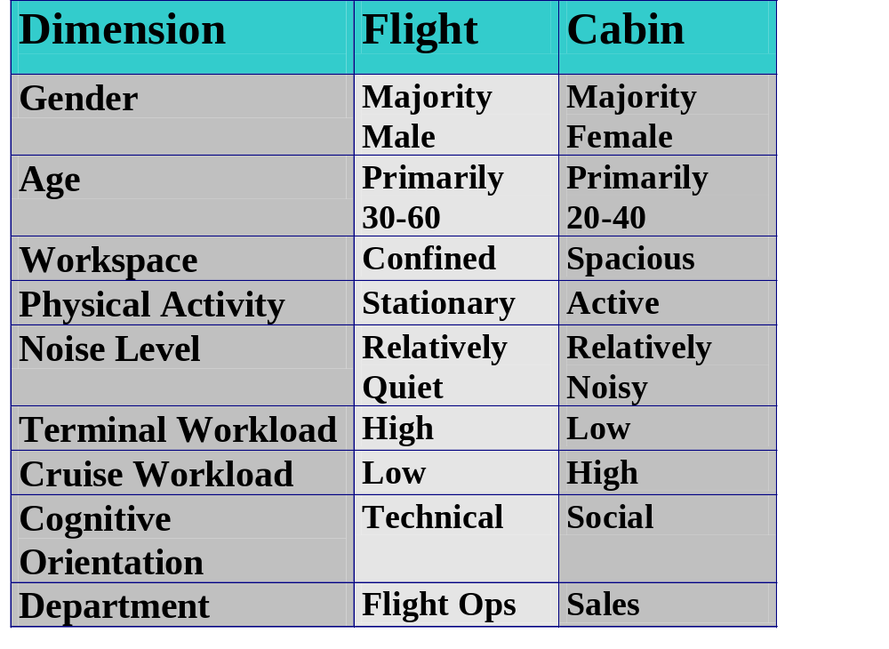
Crew Characteristics*
*These are broad generalities used to demonstrate the different work environments. For
example, it is understood that more females are becoming pilots and that the noise level in the cockpit
is often at high levels, but for different reasons than in the cabin.

Slide 7
Information Transfer Model
This model depicts barriers through which a decision to contact another crewmember must pass.
Historical
H
Physical
P
CABIN
COCKPIT
Psychosocial
P
Regulatory
R
Organizational
*From Chute and Wiener (1995)
O

Slide 8
Barriers: Historical and Physical
Historical barriers
Rigid chain of command adopted from military
Pilots and attendants assigned to separate departments
Early manuals instructed crews not to converse
Physical barriers
Cockpit door separates environments, little face-to-face communication
Cockpit personnel are generally stationary in a confined space
Cabin is spacious and involves interacting with many people

Slide 9
Barriers: Psychosocial, Regulatory and Organizational
Psychosocial barriers
Age, gender and attitude differences
Cultural influences
Labeling (flight crew vs. cabin crew)
Stress
Regulatory barriers
Sterile cockpit – limits on communication below 10,000 feet
Safety – locked cockpit door
Organizational barriers
Separation of crews into two different organizational departments
Different routine focus (safety vs. service)
Different manuals, procedures and training

Slide 10
Stress and Synergy
The barriers between the flight deck and cabin crews
can cause stress.
Stress can be particularly detrimental to successful communication and teamwork
The effects of stress are heightened during emergencies
There is good evidence from the analysis of incidents and accidents that:
  The failure of flight and cabin crewmembers to work together effectively made the situation worse
  Effective collaboration through teamwork (i.e., synergy) could have prevented some events and lessened the consequences of others

Slide 11
Using Synergy to Cope with Stress
Issue:
Stress causes fixation or “tunneling.” As a result, important information is missed because the individual focuses only on unimportant information or a single issue rather than the entire situation
This can happen to pilots, flight attendants or anyone
Solution:
The entire crew should learn about fixation and be alert for times when they or other crewmembers are fixated
Everyone should learn how to prevent or recover from a fixation
Issue:
Stress causes problems with speech
  Hurried or simplified speech is difficult to understand
  Pitch or phonetic change can hinder understanding
Solution:
It is important for all flight crewmembers to learn to control their speech under stress (e.g., in an emergency) by slowing down and pronouncing each word as clearly as possible

Slide 12
Training and Synergy
Issue:
Airlines train flight attendants to expect critical information from the cockpit in an emergency (e.g., nature of the problem, time to brace, etc.). Pilots are trained to handle the emergency first and then communicate with the cabin crew. This creates a disconnect in expectancies during an emergency.
Solution:
Airlines should integrate training manuals and procedures for pilots and flight attendants for emergency situations so each knows what the other is doing and what to expect.
Crewmembers should discuss their expectations and procedures before each flight.
Issue:
Many flight attendants do not know basic technical information about the aircraft. This can hinder clear communication.
Solution:
Flight attendants should receive basic technical training (including terminology such as engine numbering) to aid communication with pilots.

Slide 13
Recommendations to Improve Synergy
Increase mutual knowledge and awareness of issues
Cabin crew: learn technical terminology, improve reporting skills, increase awareness of pilot workload
Pilots: increase awareness of flight attendant workload, understand importance of briefings, use active listening skills
Provide appropriate behavioral options
All: Slow down, speak clearly, give positive commands
Cabin crew: Wait for response before acting
Pilots: Solicit information, give effective briefings
Opportunities for practice
Daily operations, mental rehearsal
Communication is fundamental to synergy.

Slide 14
A Good First Step Toward Synergy
Adopt a term that encompasses both flight deck and
cabin crewmembers as a team. Create and reinforce a
working environment of:
One aircraft = one crew
Close psychological distance by stressing commonality
“Teamness”
“Flight Team” “Flight Squad” “Airborne Personnel”
Use the term during a preflight all-hands briefings and try to make it official in the airline’s training and culture.

